Slide 1

SBOM with Eiffel Protocol
Eiffel Summit 2025
Helena Slívová

Slide 2

Our focus
SBOM – benefits of having one
How it can be used?
Melting with Eiffel Protocol
Your needs
2

Slide 3
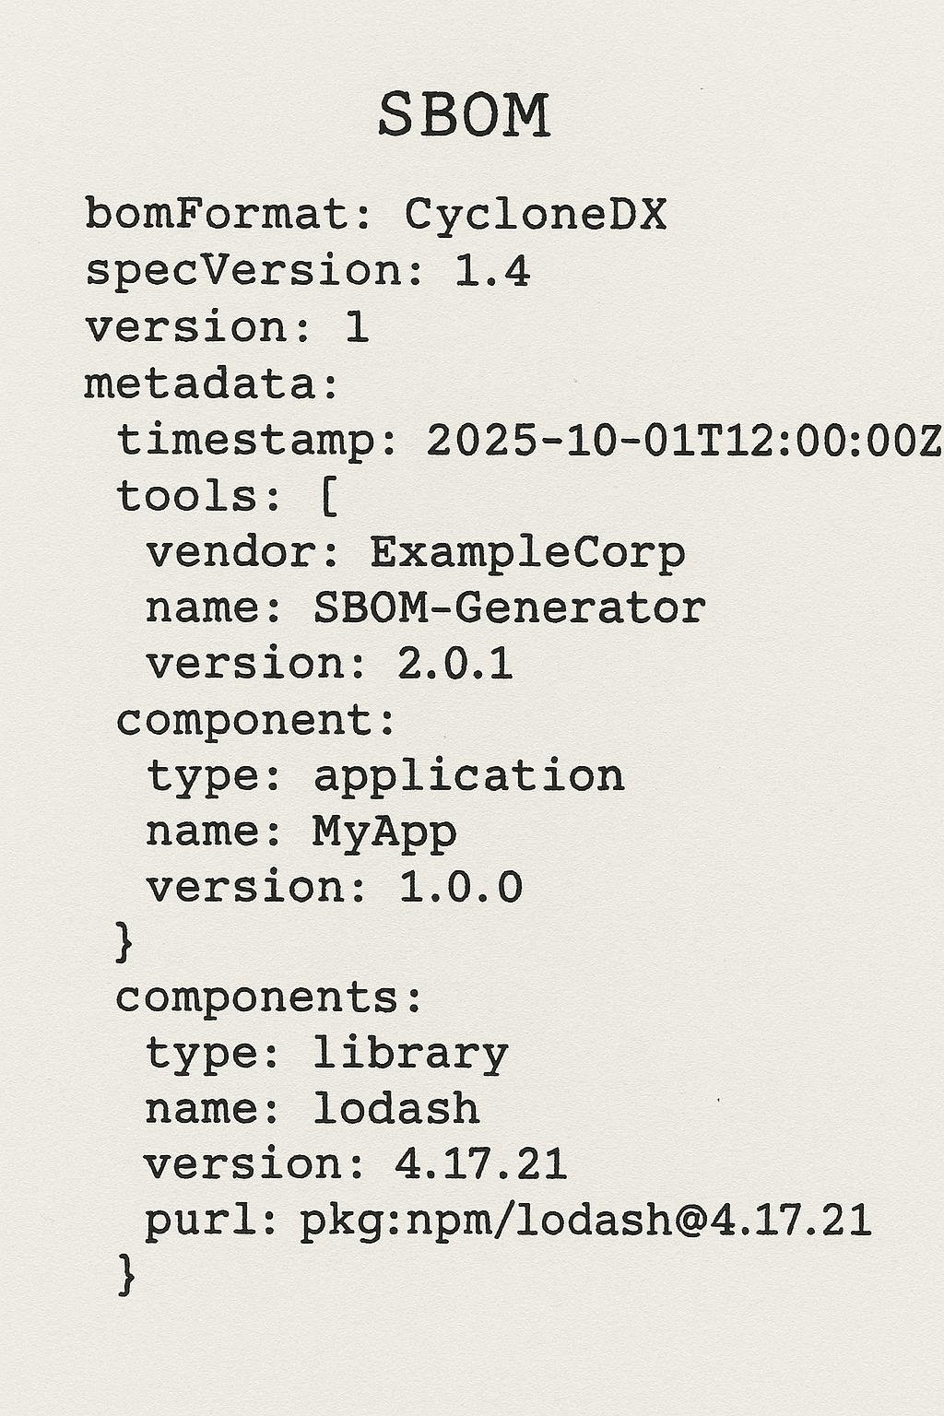
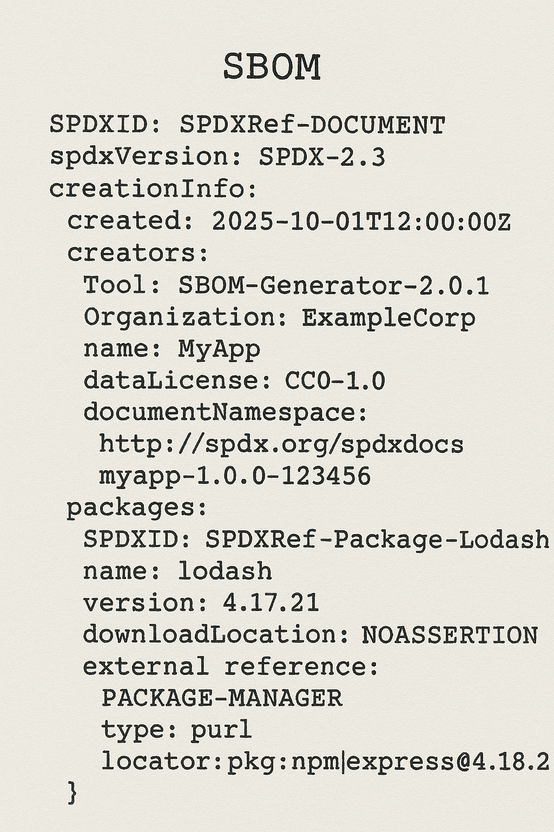
Software Bill Of Material
Detailed inventory of software product showing what other software is included.
Increase of software security
Managing software security vulnerabilities
Addressing licensing issues
Lowering supply chain risks

Slide 4

Software lifecycle
SBOM can be generated at different moments of software development lifecycle
Development
Build
Test
Deployment
Runtime
All dependencies resolved
Integrated in CI/CD pipelines
Reflects real environment
Compare with Dev/build results
Production-like
Release time compliance
Highly precise
Zero trust
Runtime compliance
Pros
Declared dependencies
Easy to automate
Cons
Transitive dependencies not resolved
Runtime env not considered
Unused dependencies
Harder tracking of exact source
Not all environments are complete
Harder to track back to build time artifacts
Complexity
Performance
Security implications

Slide 5
Melting with Eiffel protocol
SBOM reference
SBOM composition from events
Event based CI/CD solution directly challenges the thinking if there could be way how to use those events together with SBOM creation at various states of software development and deployment.
???
Other way to integrate

Slide 6
SBOM reference
Protocol evolution
Reference to existing SBOM passed as link within event sent over CI/CD pipeline
Modification of existing events
BuildEvent – adding reference to SBOM
DeploymentEvent – to include reference to SBOM of deployed version ensuring traceability
Standardize SBOM metadata
Component information
Vulnerabilities
Generator metadata

Slide 7
SBOM reference
Protocol evolution
Reference to existing SBOM passed as link within event sent over CI/CD pipeline
SBOM as an artifact
{
"eventType": "ArtifactLinkEvent",
"timestamp": "2025-09-09T16:12:45Z",
"artifact": {
"name": "build-123456-sbom",
"type": "SBOM",
"location": "https://sbom- repository.com/sbom/123456"
}
}

Slide 8
SBOM composition from events
Protocol evolution
Eiffel events passing through CI/CD pipeline and serving as source for SBOM composition
EiffelCompositionDefinedEvent – use to model component grouping for a product
EiffelArtifactCreatedEvent – modify to carry component SBOM related metadata
EiffelSBOMGeneratedEvent – new event to be triggered when specifically needed

Slide 9
SBOM composition from events
Protocol evolution
Eiffel events passing through CI/CD pipeline and serving as source for SBOM composition
Benefits
No extra SBOM scan step
Versioned and traceable
Composable
Scalable

Slide 10


What are Eiffel users needs?
Product transparency
Documentation of product structure
Event notification
On vulnerability or license issue based on SBOM presence in CI/CD
Vulnerabilities overview
Easy to find which product components are impacted
Eiffel users needs
Tracking software lifecycle
deployementEvent to include information about SBOM
Allows to verify what was deployed and if it meets standards
Dependencies and licenses
Protection from using non-approved license
Ability to see what is open source/commercial

Slide 11
Union
Brainstorm
.
Eiffel User needs
SBOM
Eiffel protocol evolution
Notes:
Note: Based on the needs brought up during the discussion, try to brainstorm all together on how to unite these needs with possible changes in protocol. Leave it as a kick start for further discussions on protocol evolution.

Slide 12


Thank you

